Slide 1

Software Development
By: Kyle Kirtland

Slide 2
Outline
Starting a Project
Use Case Diagrams
Class Diagrams
State Machine
Flow Charts/Activity Diagram

Slide 3

Starting a Project

Slide 4
What are the First Steps?
Question your self
Ask what I need to achieve
Ask how I want to achieve this goal
Ask when it is due
These 3 questions should help when coming up with a plan of action.

Slide 5
What do I need to achieve?
This question will give you a chance to break down your project into smaller easier to understand steps.
I need a robot that can move.
I need a robot that can fall out of an airplane.
I need a robot that can pick up ping pong balls.
Based on the needs we can then strategize our plans

Slide 6

How are we going to achieve?
Remember that this is a team project and no one person is going to be right 100% of the time. That is why this is a we question.
Once the leads have decided on the goals its time to brainstorm ideas
Having multiple viewpoints is always a good way to get the most effective working solution
Never dismiss what a person says

Slide 7
When is the Project Due?
When choosing a design always keep in mind time restraints
While different ideas sound easy to create it is not always going to be easy to achieve.
Try to estimate the amount of time a task will require to achieve
This will help in choosing tasks to tackle and when they need to be done

Slide 8

Use Case Diagrams

Slide 9
What is a Use Case?
Unified Modeling Language
Used to visualize relationships between actors and the actions
An actor is going to be anything/anyone that is interacting with the system.

Slide 10
Example Scenario
Find the Actors and some actions that they might do in the system.
There is a company called GoPix which works on Robots. Their current project is to work with a camera that moves 360 degrees on the yaw and 180 degrees on its pitch. They also have a team that works on a drive system which will be being controlled by a remote user. The Drive System is going to be using Tank Controls (each row of wheels are controlled by 1 stick on a remote).

Slide 11
Scenario Answer
Actors | Actions
Camera | Turn Yaw, Turn Pitch, Camera Turn on/off?
Drive Control | Turn on Right side, Turn off Right side, Turn on Left side, Turn off Left Side
Remote user | Turn on Right side, Turn off Right side, Turn on Left side, Turn off Left Side
In this case we are seeing that the system is going to have 3 actors working on or with the system. Notice that we have overlapping uses in our actions.

Slide 12
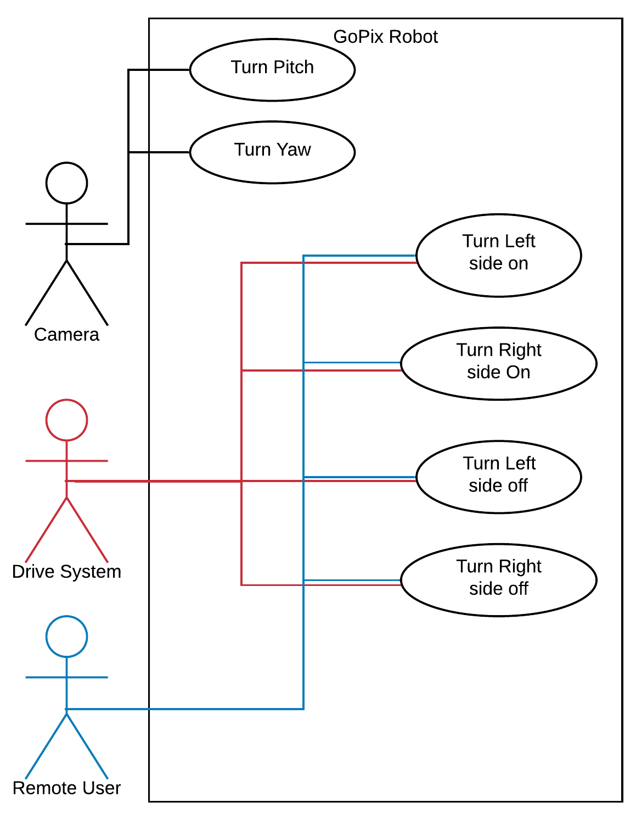
Modeling our answers
LucidChart.com
Color Scheming is not industry standard
Notice that we are reusing Use Cases
This is important so that we can see that they are interacting with each other.

Slide 13

Class Diagram

Slide 14

What is a Class?
A class is an object that it going to contain the actions that are to be done with that object.
These classes are meant to be objects that hold multiple of an item
In many cases we can think of these objects as the nouns of a sentence.

Slide 15
What Does it Do?
By placing all of the classes into a centralized space we can start to see what should and shouldn’t be a class
How do they interact with each other?
EXAMPLE
There is a hospital that describes that they need a system that allows their nurses to connect to a database on the hospitals network. The database holds patient details and prescription needs. The nurses then use the system to get prescriptions for the patients. Find all the potential classes.

Slide 16
ANSWER
Potential Classes: Nurse, Patient, Prescription, Hospital, database
What might each of these classes hold? Do they have the potential of having multiples?
Class | Detail
Nurse | ID, Name, Position, workLocation
Hospital | ID, Name, Address, AmountOfPatients
Patient | ID, Name, Nurses, Prescriptions, HospitalID
Prescription | ID, drugType, Amount
database | This holds data. Therefore, not a class
Expansion

Slide 17
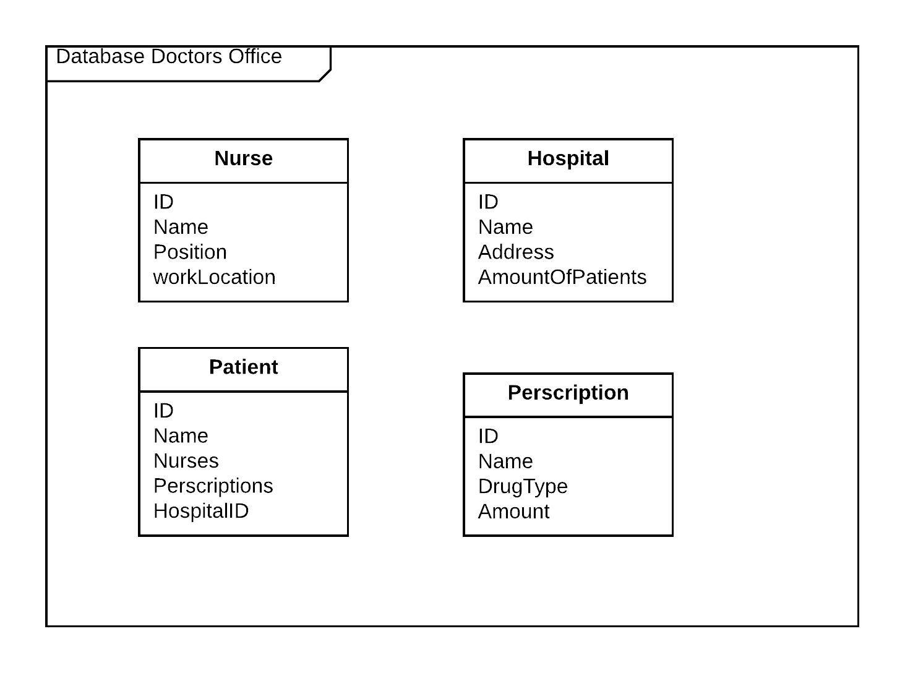
Making the Diagram
* If you notice we are showing a more visual version of our data which helps to illustrate how the classes might work together

Slide 18
Flow Diagrams/Charts

Slide 19
What Does it Do?
Flow Charts are a way to organize how your machine or process is going to go from one step to the next.
Lets think of this as a way to organize how a process is going to happen.
EXAMPLE:
We have a Robot that is at point A and wants to go to point B. There is a corridor that connects the two rooms together and doors that are closed to the corridor on each of the rooms. How do we get the robot to its objective?
Next we want to pick up an item in Room B and bring it to Room A.

Slide 20
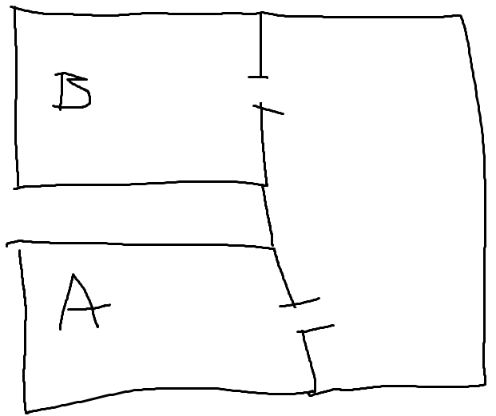
Let’s Visualize the Situation
Now that we can see the layout we can get a better understanding of what the robot needs to do to get to the objective. Now we need to come up with functions that will allow the robot to do its job.

Slide 21
Functions
A function is a set of tasks that will allow a program to make it to a goal on the previous slide we saw a door that was closed.
One of the functions that we might want to have is an “Open Door” function.
This is a way to cut back on the amount of code an a way to better explain a system.

Slide 22
Putting it Together
EXAMPLE:
Base Functions:
Move
Open Door
Pickup Item
Drop Item
What are the objects that are going to be interacted with?

Slide 23
Objects
An object is as previously mentioned an item that can either be physically touched or visualized.
In our case this would be
The robot, the door, the locations, and the box/ object that is being picked up.

Slide 24
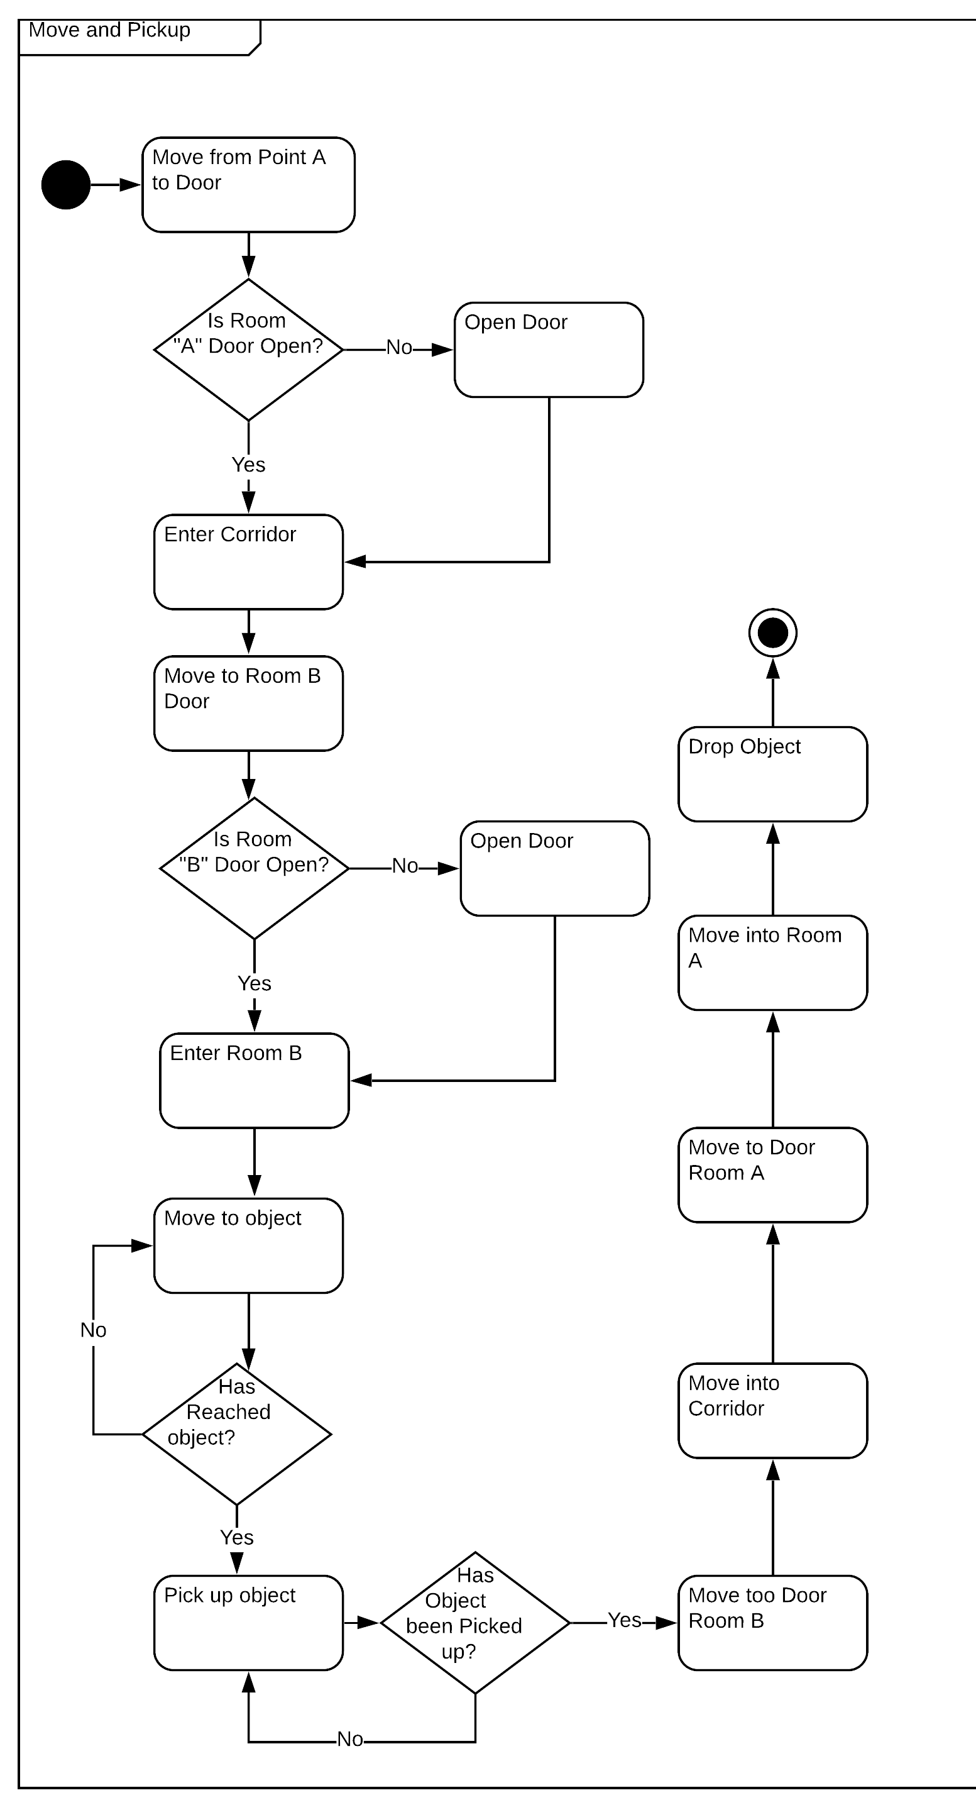
Creating a Layout

Slide 25
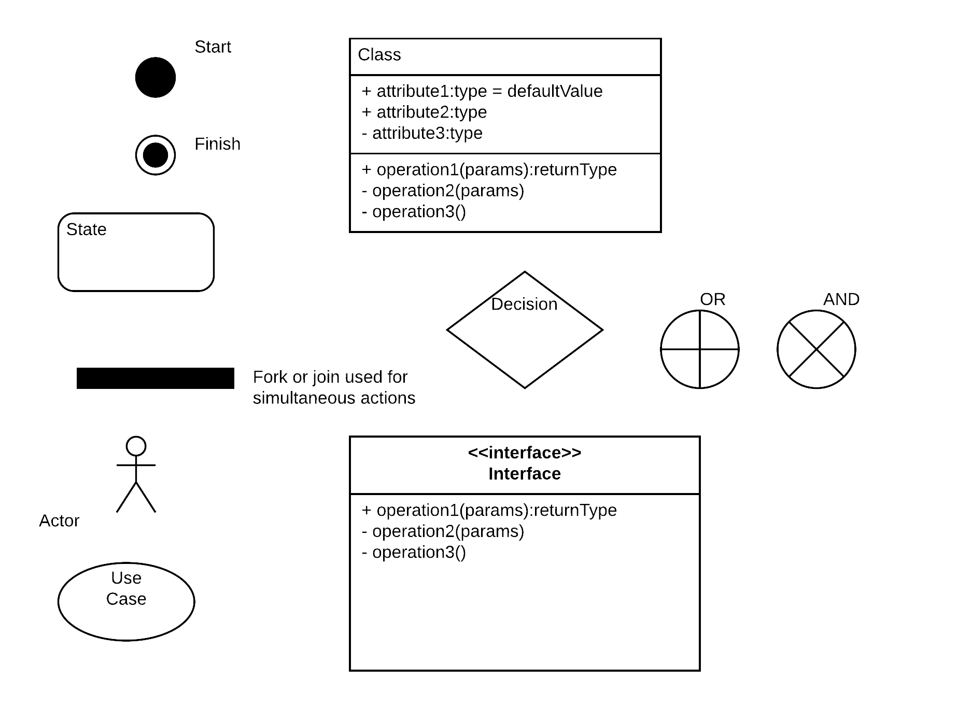
Helpful Diagram Reminders
Do you remember what these are used in?

Slide 26

Any Questions?

